Slide 1
2022 Major Release Design Kit Update fetm, ftcv
DD/LDF/Ollie
Version MR202201

Slide 2
2022 fetm major release

Slide 3


Fetm update
UPF flow
generate ETM by upf
Litmus
To replace CCD in ftcv checking constraint rule
Litmus can be only applied on the os7 machine
Env
source ~cadman/env/FTC.env
source ~cadman/env/fetm.env

Slide 4
Extract model original flow vs upf flow
Primetime Extract model
Add related_power_pin
Add fa_related_power
Add internal_power
Add leakage_power
Library Compiler generate db
Gen upf and no_pg netlist
Primetime Extract model with upf
Add leakage_power
Design Compiler generate pglib
Add pad information
Add pad information
Library Compiler generate pgdb
Primetime Extract model
Add pad information
Add leakage_power
if $GEN_NO_PG_ETM
Step 4.5
original flow
Step 5
Step 5
Step 5
upf flow
Step 6.5

Slide 5
step 1
check control file
step 2
Run genrp to generate *fapower
step 3
Check database
step 4
step 5
step 6
Use *fapower to generate pgmap
Modify SDC by removing boundary constraints
Run Primetime to generate ETM lib file
Move ETM libs and other necessary files to output folder
step 6.5
step 7
Generate pglib and pgdb from ETM libs (dc_shell, lc_shell)
Check ETM lib’s timing arc (CCD)
Generate db file (lc_shell)
step 1
check control file
step 2
Run genrp to generate *fapower
step 3
Check database
step 4
step 5
step 6
Use *fapower to generate pgmap
Modify sdc adjusting rule
Run Primetime to generate ETM lib with pg information by ETM upf flow
Move ETM libs and other necessary files to output folder
step 6.5
step 7
Modified
Check ETM lib’s timing arc (by Litmus, CCD, NO)
step 4.5
Generate upf file and no_pg netlist
Fetm will skip step 6.5 if ETM upf flow

Slide 6
fetm I/O chart (GEN_ETM_BY_UPF flow)
Sign off/ Dream System
PG Netlist
(*.v)
Timing Constraint
(*.sdc)
Powervalue list
Pad pin list file
RC files
(*.spef)
(if 28nm)
AOCV_TABLE
pgmap
(*.pamap)
fetm control file
Core , IO , Macro, IP Library
(*.lib *.db)
optional
necessary
Fetm
ETM lib
(*.pglib.gz, *.lib.gz)
Arc report
(.arcrpt, noarcpins.lis)
Log
(fetm.log)

Slide 7
fetm input / output
Sign off/ Dream System
Netlist
(*.v)
Timing Constraint
(*.sdc)
powervalue list
Pad pin list file
RC files
(*.spef)
(if 28nm)
AOCV_TABLE
pgmap
(*.pamap)
fetm control file
Core , IO , Macro, IP Library
(*.lib *.db)
optional
necessary
Fetm
ETM lib
(*.pgdb, *.db
*.pglib.gz, *.lib.gz)
Arc report
(.arcrpt, noarcpins.lis)
Log
(fetm.log)

Slide 8
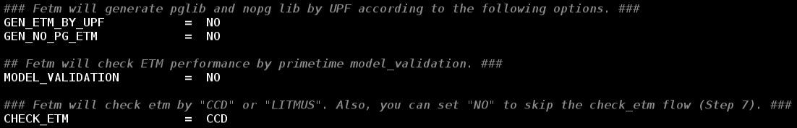
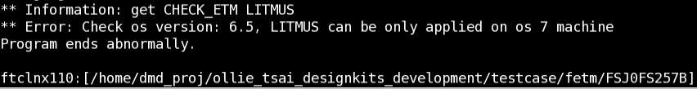
Fetm control file
genctrl (default | other options)
GEN_ETM_BY_UPF = NO | YES generate ETM.pglib
GEN_NO_PG_ETM = NO | YES generate ETM.lib
MODEL_VALIDATION = NO | YES
CHECK_ETM = CCD | LITMUS | NO
Fetm will go original flow if the options is all unset or set to default
Fetm will check the os version if CHECK_ETM is set to LITMUS

Slide 9
Output files & New options in control file
Fetm
orinigal flow
GEN_ETM_BY_UPF
lib.gz db
pglib.gz pgdb
NO
Original flow
MODEL_VALIDATION
YES
NO
UPF flow
pglib.gz
YES
Model validation
gba.out pba.out
GEN_NO_PG_ETM
NO
YES
CHECK_ETM
NO
Gen no_pg ETM
CCD/LITMUS
Check ETM
arc.rpt
etm_check.rpt
lib.gz
Fetm ends

Slide 10
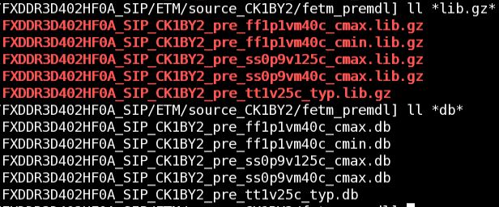
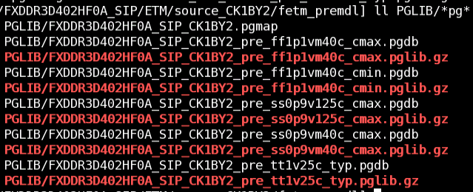
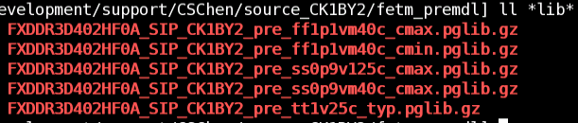
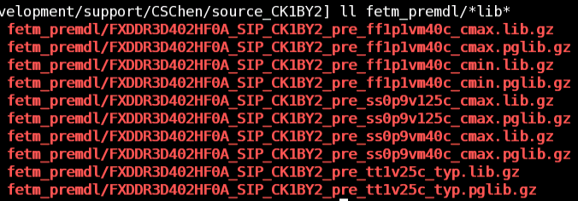
Output ETM file
Original flow
ETM.lib.gz、ETM.db PGLIB/ETM.pglib.gz、PGLIB/ETM.pgdb
UPF flow
GEN_ETM_BY_UPF = YES GEN_ETM_BY_UPF = YES
GEN_NO_PG_ETM = NO GEN_NO_PG_ETM = YES
ETM.pglib.gz ETM.lib.gz、ETM.pglib.gz

Slide 11
Step 4 - modify sdc adjusting rule
Original
set_operating_conditions
set_input_transition
set_input_delay
set_output_delay
set_clock_uncertainty
set_max_transition
set_load
set_drive
set_driving_cell
set_timing_derate
set_propagated_clock
remove_propagated_clock
Modified
set_max_delay

Slide 12
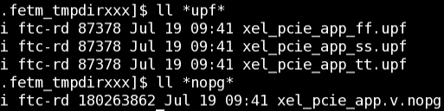
Step 4.5 - add genupf
Add new option “GEN_ETM_BY_UPF = { YES | NO }”, default is NO
Input file
powervalue.list
${design}.pgmap
${design}.v
Output file
${design}_{ss|tt|ff}.upf
${design}.v.nopg
Fetm gets power & ground information from powervalue.list and pgmap for generating upf file with ETM upf flow.
Fetm parses netlist and pgmap to generate no pg netlist for ETM upf flow

Slide 13



Step 4.5 - add genupf
powervalue.list is necessary for GEN_ETM_BY_UPF flow
fetm returns error if POWERFILE is missing
powervalue.list
user have to fill in power ground information according to the pgmap
Turn on the POWERFILE option, and fill in the POWERFILE name in fetm.control

Slide 14
Step 5 - add model validation
Fetm goes model_validation flow if MODEL_VALIDATION is set to YES
MODEL_VALIDATION = { NO | YES }
Model validation flow generates two timing report of design and ETM wrapper, and compares the two timing reports to check the performance of ETM.
Model validation related file will be put in the directory, “.fetm_tmpdirxxx/model_validation/”
design.tim timing report of design
model.tim timing report of ETM wrapper
*.gba.out compare_interface_timing of design.tim and model.tim
*.pba.out compare_interface_timing of design.tim and model.tim after pba
Model validation can’t be applied in DMSA mode (VNC)
The command added into primetime script for model validation
set_app_var hier_modeling_version 2.0
extract_model -validate timing …

Slide 15
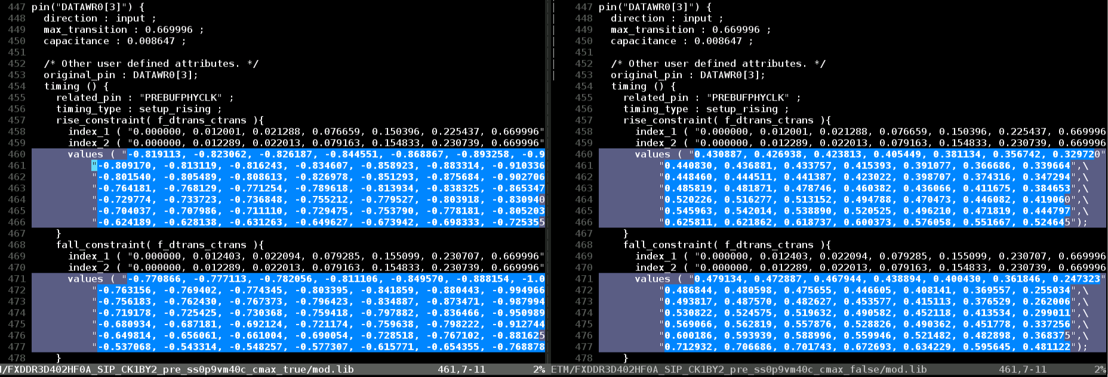
Step 5 - modify primetime setting, fixed 2022/07/25
Original
set extract_model_include_mcp_in_arc_value false
Modified
set extract_model_include_mcp_in_arc_value false
mcp true mcp false
0.430887 - (-0.819113) = 1.25
0.426938 - (-0.823062) = 1.25

Slide 16
Step 5 - modify primetime setting
Add (for gen_etm_by_upf flow)
set enable_golden_upf true
set extract_model_include_upf_data true
set extract_model_upf_supply_precedence internal
Add (for model validation flow)
set hier_modeling_version 2.0
set model_validation_output_file *.pba.out
set model_validation_save_session false

Slide 17
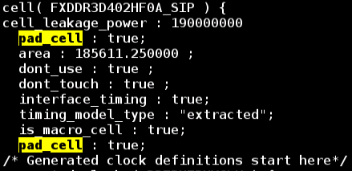
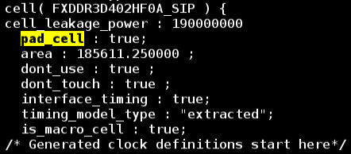
Step 5 - modify
Fetm will return error while not applying “read_aocvm” command with the option “timing_aocvm_enable_analysis” is set to true during aocv flow
set timing_aocvm_enable_analysis true|false
Remove addmargin in Step 5
The user-defined margin added into ETM is no longer allowed.
Fix pad_cell attribute in ETM
pad_cell will no longer being added twice

Slide 18
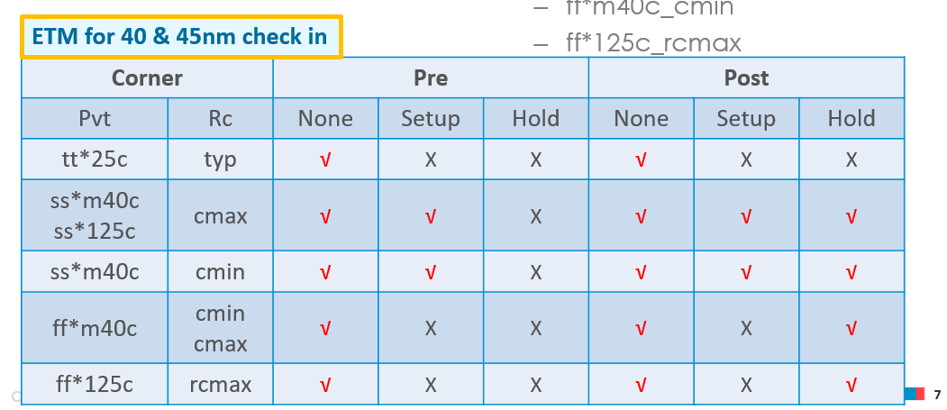
Step 5 - modify
Add the ss*m40c_cmin corner for 40 nm in fetm_signoff_criteria
file:///U:\DesignKitUsage\fetm\fetm_sign_off_corner.pptx
Fix the missing setup_ ss*m40c_cmin corner for 40 nm
before
After

Slide 19
Step 6.5 - modify
Fetm will generate ETM.pglib and ETM.pgdb at step 6.5 with dc_shell and lc_shell in original flow.
Fetm will skip step 6.5 in ETM upf flow if the option “GEN_ETM_BY_UPF” is set to “YES”

Slide 20
Step 7 - modify
Add a new option in control file “CHECK_ETM = {NO|CCD|LITMUS}”, default is CCD
“CHECK_ETM = NO”
For pre stage, the ETM boundary constraint may be too complex to be checked
Fetm will skip checking constraint rule
“CHECK_ETM = CCD“
Fetm will check the constraint rule with CCD (original flow)
“CHECK_ETM = LITMUS”
Fetm will check the constraint rule with Litmus
Litmus can be only applied on the os7 machine

Slide 21
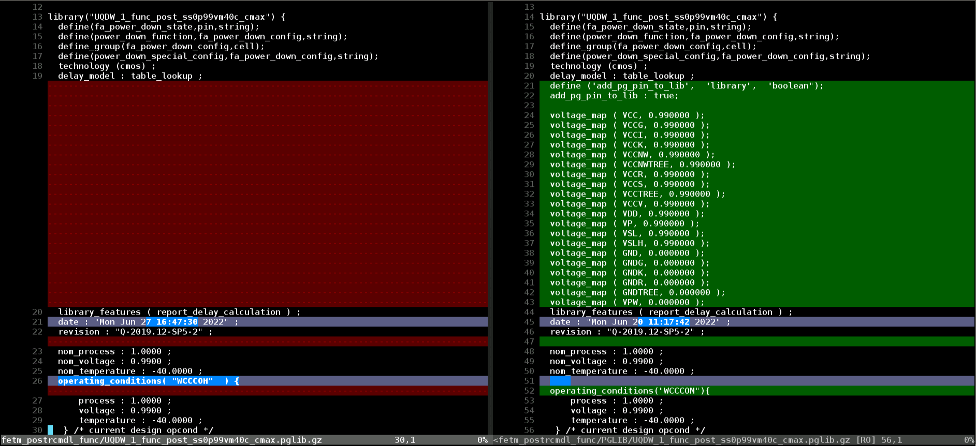
Comparison of ETM upf flow and original flow
1

Slide 22
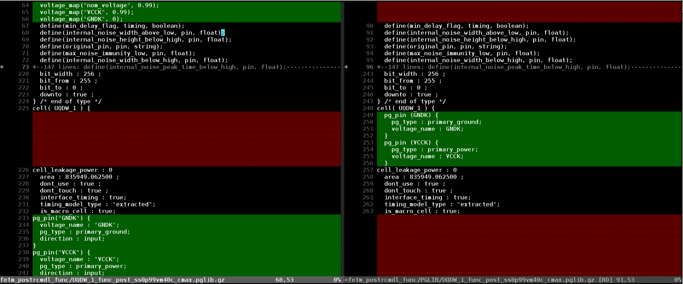

Comparison of ETM upf flow and original flow
1
2
2

Slide 23
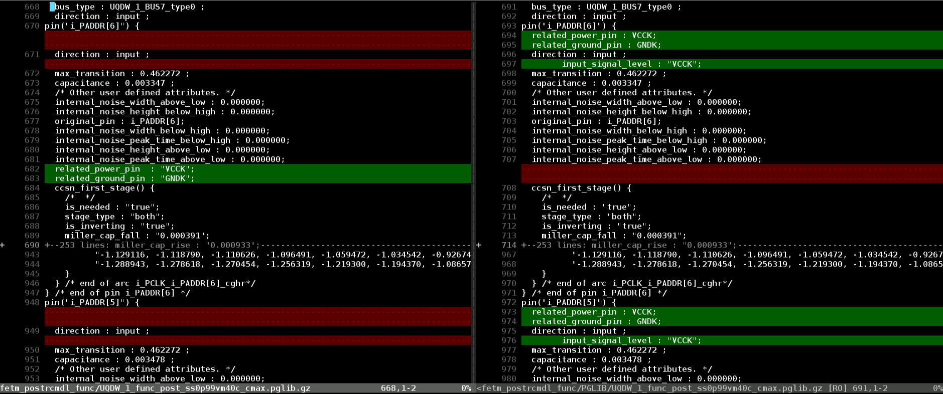
Comparison of ETM upf flow and original flow
3
3

Slide 24
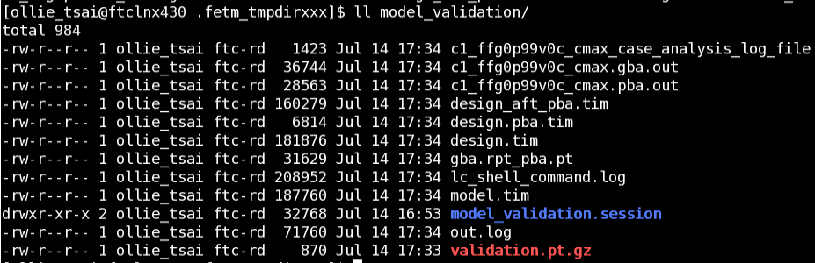
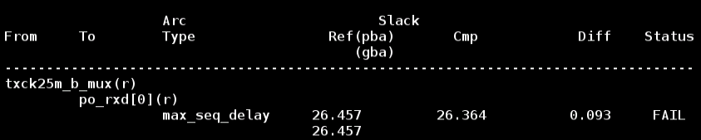
Model validation usage

Slide 25
Model validation usage
Fire primetime with design and ETM wrapper
Step 1: Modify pt script ( .fetm_tmpdirxxx/c*gen*.pt )
set model_validation_save_session true (fetm default setting is false)
#quit (remark “quit” at the end of pt script)
Step 2: Fire primetime and build design
% pt_shell -f ${primetimeScript}
Step 3: Fire primetime and build ETM wrapper
% pt_shell
pt_shell> restore_session model_validation/model_validation.session

Slide 26
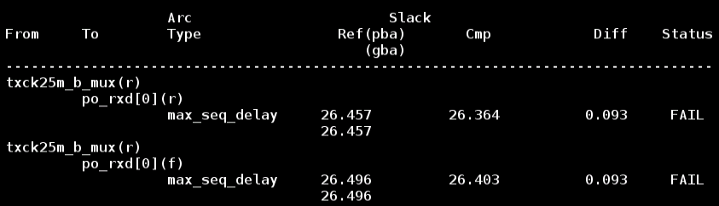
Model validation usage
report_timing -rise_from txck25m_b_mux -rise_to po_rxd[0] -delay_type max -significant_digits 3
report_timing -rise_from txck25m_b_mux -fall_to po_rxd[0] -delay_type max -significant_digits 3
Ref: slack from design
Cmp: slack from ETM wrapper
Diff: $Ref - $Cmp

Slide 27
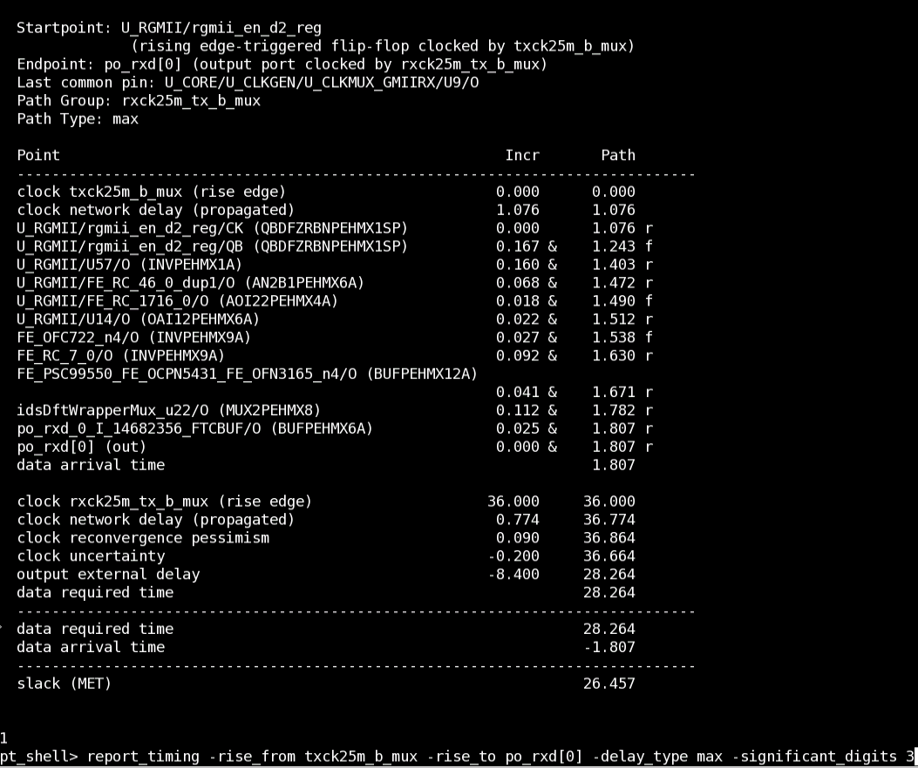
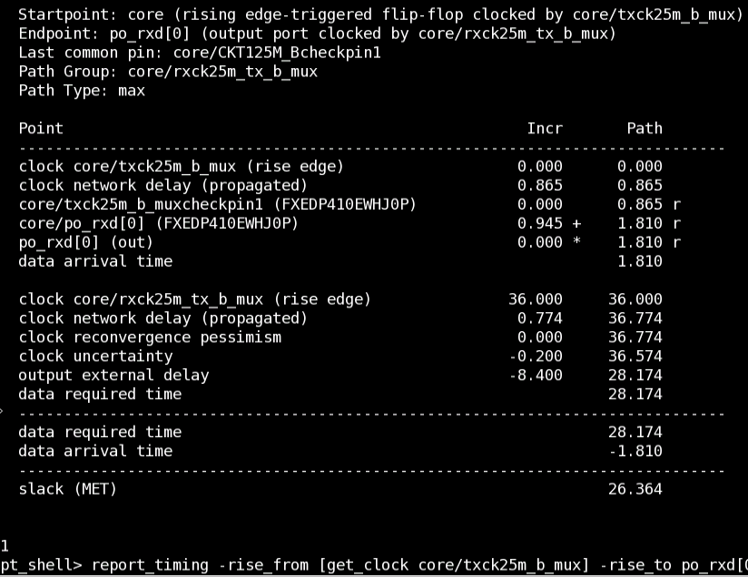
Model validation usage
ETM wrapper
Design

Slide 28
2022 ftcv major release

Slide 29
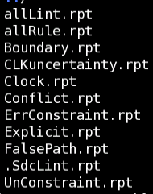
Ftcv update
Litmus
To replace CCD in ftcv checking constraint rule
Current rule reference checking by CCD are not all supported by Litmus
U:\DesignKitUsage\ftcv\CCD_LITMUS_rule_reference.pptx
U:\DesignKitUsage\ftcv\litmus_rulereference_22.10.pdf
Litmus flow
source ~cadman/env/FTC.env
source ~cadman/env/ftcv.env
ftcv val $proj pre litmus
Output file
litmus/*
.ftcv_litmus.log

Slide 30
Ftcv checking reports
litmus/*
allLint.rpt
check all constraint lint
allRule.rpt
check all constraint rule
Boundary.rpt
check io delay
CLKuncertainty.rpt
check clock uncertainty
Clock.rpt
check clock related constraint
Conflict.rpt
check sdc design

Slide 31
Ftcv checking reports
litmus/*
Explicit.rpt
check exceptions
FalsePath.rpt
check false paths
UnConstraint.rpt
check CLK_DEF1
Unconstrained clock: A clock pin does not belong to any clock tree (missing create_clock or create_generated_clock command)

Slide 32
Confidential information
The material is being disclosed to you pursuant to a non-disclosure agreement between you or your employer and Faraday. Information disclosed in this presentation may be used only as permitted under such an agreement.
Legal notice
The information contained in this presentation is intended to provide a general guide as to which product is suited for a given requirement and shows suggested product applications. Specified functions and properties for products are only valid when handling instructions and other stated conditions and recommendations have been considered and followed. All descriptions, illustrations and dimensions in the information represent general particulars and do not form part of any contract. All information is provided “as is”, with no guarantee of completeness, accuracy, timeliness or of the results obtained from the use of the information, and without warranty of any kind, express or implied, including but not limited to warranties of performance. All information is subject to change without prior notice. Faraday assumes no responsibility whatsoever for any errors or inaccuracies about the information.

